Slide 1


Lymphoma Subtype Classification Using Neural
Networks To Support Human Hematopathologist
decisions
Chiara Fantinato, Riccardo Malgarotto Boschiero
Human Data Analytics
Academic Year 2022/2023
Notes:
INIZIO RICCARDO

Slide 2

Outline
Introduction
Dataset
Pre-processing
Processing Pipeline
ResNet50-based architecture
ResNet built from scratch
Heatmaps
Visual attention mechanism
Results
Concluding Remarks

Slide 3
Introduction
Background
Lymphoma is a type of cancer that begins in lymphocytes.
The delivered treatment depends on the type of the lymphoma.
Lymphoma subtype classification is a complex task even for expert hematopathologists.
Implementation of algorithms for the automated classification of Lymphoma subtypes could be helpful to support physicians' decisions.
Deep learning models struggles to show impact in medical domain due to a lack of transparency.
Aim of the study
Perform lymphoma subtype classification using neural networks.
Provide visual explanations for machine’s decisions.
1
Notes:
CHIARA
Lymphoma is a type of cancer that begins in lymphocytes, which are the infection-fighting cells of the human body. To deliver the best treatment it is important to identify the lymphoma subtype. Lymphoma subtype classification is a complex task even for expert hematopathologists. For this reason, the implementation of algorithms for the automated classification of Lymphoma subtypes could be helpful in supporting physicians' decisions. It is of importance to notice that if deep learning models are exploited to reach this goal, they struggles to show impact in medical domain due to a lack of transparency.
The main aims of this project are performing lymphoma subtype classification using neural networks to support Human Hematopathologist decisions, such as the delivered treatment, and also visual explanations for machine’s decisions.

Slide 4
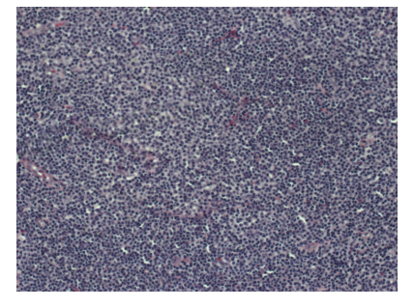
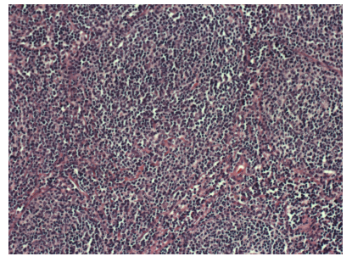
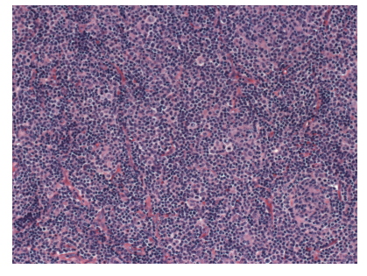
Dataset
374 images of size 1388x1040
113 images for Chronic Lymphocytic Leukemia (CLL)
139 images for Follicular Lymphoma (FL)
122 images Mantle Cell Lymphoma (MCL)
Large degree of staining and sectioning variation.
Randomly divided into training, validation, and test set according to 6:2:2.
CLL
FL
MCL
2
Notes:
The dataset on which we based our work consists of 374 images of size 1388x1040 with 113 images for Chronic Lymphocytic Leukemia (CLL), 139 images for Follicular Lymphoma (FL) and 122 images Mantle Cell Lymphoma (MCL). The dataset includes samples prepared by different pathologists at different sites, resulting in a large degree of staining and sectioning variation. It has been randomly divided into training, validation, and test sets, made of 60%, 20%, and 20% images respectively. Training set is used for learning; validation set is used for tuning hyper-parameters and model optimization; test set is used to assess generalization ability of models.

Slide 5
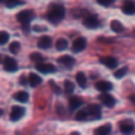
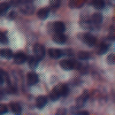
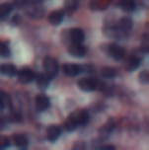
Pre-processing (1)
Artifact management
3x3 gaussian filter.
Images affected by artifacts detected automatically.
Variance of image filtered using a Laplacian filter greater than 700 → Presence of artifacts
No artifacts
Artifacts
Filtered
3
Notes:
Starting from the observation found in literature about a pattern between misclassified images and presence of some type of artifacts created during the scanning process, we thought that poor quality of slides could impact on model performances, and we decided to remove artifacts from affected images using a 3x3 gaussian filter. Images affected by artifacts were detected automatically by considering the variance of images filtered through a Laplacian filter: variance values greater than a certain threshold corresponds to presence of artifacts. Considering the training set, we observed that 700 was a robust threshold.
The dataset is pre-processed using a gaussian filter to remove possible artifacts, histogram equalization to enhance contrast, Macenko normalization to reduce the high degree of staining variation. It is also augmented by dividing images into patches or rotating and/or flipping them to avoid overfitting. When images are divided into patches, the designed class for the entire image is the class with the highest number of votes. When images are not divided into patches, they are resized to lower dimensions for reducing computational efforts.

Slide 6
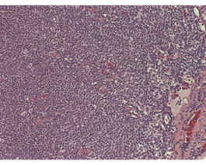
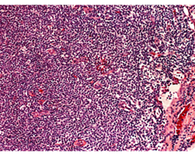
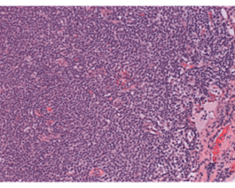
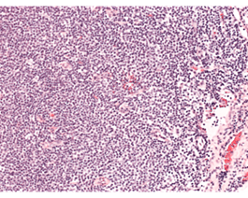
Pre-processing (2)
Histogram equalization → improve image contrast
Macenko normalization → reduce the staining variation in histological slides
Original
Histogram eq.
Macenko norm.
Hist eq. + M. norm.
4
Notes:
Our pre-processing pipeline includes also histogram equalization, to stretch out the intensity range and improve image contrast, and/or Macenko normalization, which is a technique to reduce the staining variation in histological slides.

Slide 7
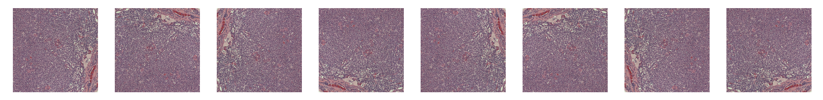
Pre-processing (3)
Data Augmentation
Split images into patches
Resize images from 1388x1040 to 1300x1040 and split into 20 non-overlapping patches of 260x260 with a stride of 260
Resize images from 1388x1040 to 1300x1040 and split into 63 overlapping patches of 260x260 with a stride of 130
Probability of belonging to a class is obtained by summing the output probabilities of each patch
Rotate and/or flip images (after resize from 1388x1040 to 224x224): 8 rotated and flipped versions of each image were retrieved
5
Notes:
FINE RICCARDO
Due to the restricted dimension of the dataset, we augmented the dataset by splitting images into patches or by rotating and/or splitting them. Patches were created in two ways using the training set: by resizing the images from 1388x1040 to 1300x1040 and splitting each of them into 20 non-overlapping patches of 260x260 with a stride of 260; by resizing the images from 1388x1040 to 1300x1040 and splitting each of them into 63 overlapping patches of 260x260 with a stride of 130. When images were divided into patchesProbability of belonging to a class is obtained by summing the output probabilities of each patch. Through transformations, 8 rotated and flipped versions of each image were retrieved. When images were not divided into patches, they were resized from 1388x1040 to 224x224.

Slide 8
ResNets
Residual block
Basic elements of ResNets:
Convolutional block
Residual block
Input
Conv block
Conv
Input
BN
ResNet50
Conv
ReLU
Transfer learning: weights initialized weights computed on ImageNet and then adapted to our dataset.
BN
Conv
ReLU
BN
Output
Addition
ReLU
Output
6
Notes:
INIZIO CHIARA
In this work we focused on ResNets, which basic elements are the confolutional block and the residual block.
We can divide our modeling process into two parts. Firstly, we used transfer learning, by fine-tuning on our datasets pre-trained models on Imagenet data from Keras and in particular we opted for ResNet50.

Slide 9
Proposed ResNet Architecture
Input image
Conv block (32, 1x1)
Conv block (64, 1x1)
Conv block (128, 1x1)
Residual block (32, 3x3)
Residual block (64, 3x3)
Residual block (128, 3x3)
Residual block (32, 1x1)
Residual block (64, 1x1)
Residual block (128, 1x1)
Max pooling (2x2)
Max pooling (2x2)
Global average pooling
1st block
2nd block
3rd block
Softmax
7
Notes:
In the second part of our modeling process, we built a ResNet from scratch to investigate if comparable performances were possible by decreasing model complexity. As a matter of fact, our ResNet parameters have almost 450,000 instead of almost 23,000,000 for ResNet50.

Slide 10
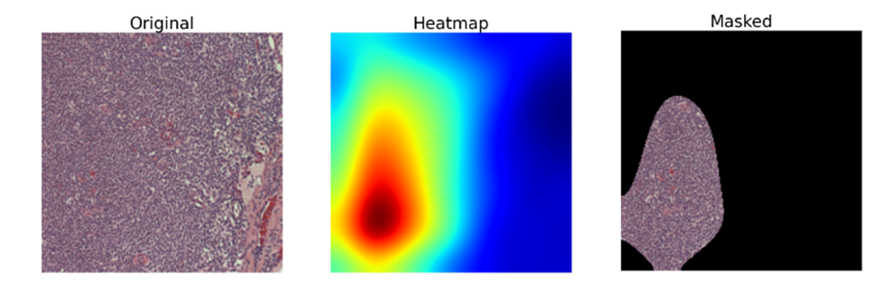
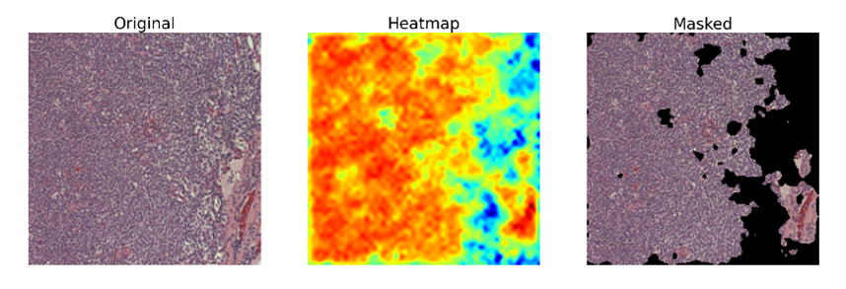
Heatmaps
Idea: Provide visual explanation for machine’s decisions.
Heatmaps: Weighted average of the last convolution layers using as weights the parameters the last dense layer.
Validity of heatmaps:
Mean of the ratios between
Number of non-zero pixels in the intersection image
Number of non-zero pixels in the image obtained by summing all the masked images related to that image
Number of images without intersection
8
Notes:
Based on the idea of providing visual explanation for machine’s decisions we extracted heatmaps from a weighted average of the last convolution layers using as weights the parameters the last dense layer.
Since clinical indications were not available, we decided to find a way to evaluate the validity of the areas of interest indicated by the heatmaps. When we performed data augmentation by rotating and flipping images, we got 8 versions of each slide. Since it is reasonable to think that, if the network works well, it must recognize consistent important areas among different versions of the same image, we evaluate the intersection of the masks obtained from the heatmaps of these images. The intersection image was created setting to one the pixels identified as important by at least 4 masked images out of 8. Particularly, we computed for each image the ratio between the number of non-zero pixels in the intersection image and the number of non-zero pixels in the image obtained by summing all the masked images related to that image, and we compute mean. We also retrieved the number of images without intersection.

Slide 11
Visual attention meachanism
Idea: Histological lymphoma features could be focused on a restricted area of the slide.
Heatmap
Th = 0.6
Image
Masked image
Global branch
Local branch
Fusion branch
9
Notes:
Based on the idea that histological lymphoma features could be focused on a restricted area of the slide and inspired by the approach of Guan and colleagues to perform thorax disease classification on chest X-ray images, we treated the already crated model as global branch, aimed to classify based on the whole images, and we created another model to be used as the local branch, aimed to classify by focusing its attention on restricted areas of the images. We fed the local branch using masked images obtained creating a mask by scaling heatmaps generated from the global branch between 0 and 1 and applying a 0.6 threshold. The fusion branch computes the final class by concatenating the last pooling layers of both the global and the local branches.

Slide 12
Results (1)
ResNet50: 10 epochs, 32 batch size, AdaMax optimizer, variable learning rate from 0.001 to 0.0001
Proposed ResNet: 15 epochs, 32 batch size, AdaMax optimizer, variable learning rate from 0.001 to 0.0001
Best pre-processing: gaussian filter to remove artifacts, non-overlapping patches data augmentation (histogram equalization an Macenko normalization are not useful)
Model | Test accuracy [%]
Orlov et al. [2] | 98.00
Andrew Janowczyk and Anant Madabhushi [4] | 96.58
Tambe et al. [5] | 97.33
Zhang et al. [6] | 98.63
Hathem et al. [7] | 98.70
ResNet50 | 98.67
Proposed ResNet | 94.67
10
Notes:
The optimization process of the architecture based on ResNet50 results in 10 epochs, 32 batch size, AdaMax optimizer, and variable learning rate from 0.001 to 0.0001 as the best setup.
The optimization process of the proposed ResNet results in 15 epochs, 32 batch size, AdaMax optimizer, and variable learning rate from 0.001 to 0.0001 as the best setup.
Results shows that the best performances are obtained on the dataset pre-processed to remove artifacts and augmented by splitting each image into non-overlapping patches: histogram equalization and Macenko does not improve classification.

Slide 13
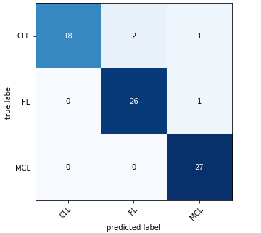
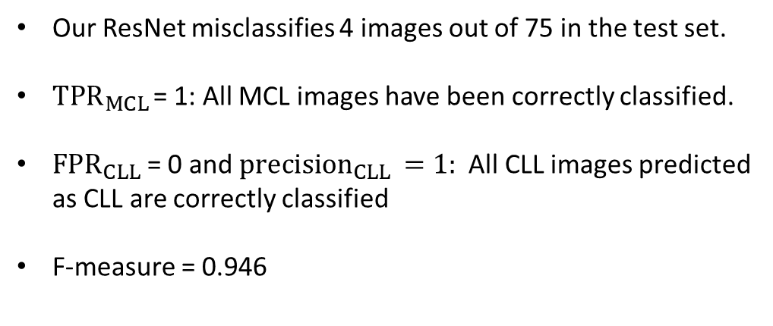
Results (2)
Our ResNet misclassifies 4 images out of 75 in the test set.
$TPR_{MCL }$= 1: All MCL images have been correctly classified.
${FPR}_{CLL}$= 0 and ${precision}_{CLL }=1:$ All CLL images predicted as CLL are correctly classified
F-measure = 0.946
Class | TPR | TNR | FPR | Precision
CLL | 0.857 | 1 | 0 | 1
FL | 0.963 | 0.957 | 0.043 | 0.929
MCL | 1 | 0.957 | 0.043 | 0.931
11
Notes:
For the proposed ResNet we computed also the confusion matrix, which shows that our machine misclassifies 4 images out of 75.
In addition, we computes the TPR, TNR, FPR, and precision for each class, and we particularly care about high TPR values because we want to identify lymphoma sybtypes to take intervention, and so we want that what we identify as positive would be really positive. From the table we can see that MCL class has TPR equal to 1 denoting that all its images have been correctly classified. Instead CLL class has FPR equal to 0 and precision equal to 1 showing that all the images predicted as CLL are correctly classified.
Finally, we computed F-measure as an alternative metric to accuracy and it was equal to 0.946.
NOTES:
TPR = sensitivity = recall = true positive/positive
TNR = specificity = true negative/negative = 1 - FPR
Precision = positive predictive value = true positive/predicted positive
F-score = 2*(precision*recall)/(precision + recall), to be used in case of unbalanced dataset
To take intervention we would like to have high TPR: we want that what we identify as positive is really positive.
In a screening scenario we would like to have high TNR: we want that what we identify as negative is really negative

Slide 14
Results (3)
Validity of heatmaps
Model | Mean [%] | Images without intersection
ResNet50 | 40 | 10
Proposed ResNet | 60 | 0
Validity of heatmaps seems to be higher for the proposed ResNet.
Visual attention mechanism
Model | Branch | Training accuracy [%] | Validation accuracy [%]
ResNet50 | Global | 99.72% | 98.67%
 | Local | 100% | 98.67%
 | Fusion | 100% | 98.67%
Proposed ResNet | Global | 98.00% | 97.33%
 | Local | 99.00% | 83.00%
 | Fusion | 99.83% | 93.33%
Accuracy decrease by adding to the model a local branch which focused on a restricted area of the images.
12
Notes:
According to our metrics, validity of heatmaps seems to be higher for the proposed ResNet because the average proportion of common pixels is higher and the number of images without intersection is zero, while for ResNet50 is 10.
We demonstrated that the introduction of visual attention in our architectures doesn't works for the exploited dataset. As matter of fact, the accuracy decreased by adding to the model a local branches which classifies focusing on a restricted area of the images.

Slide 15
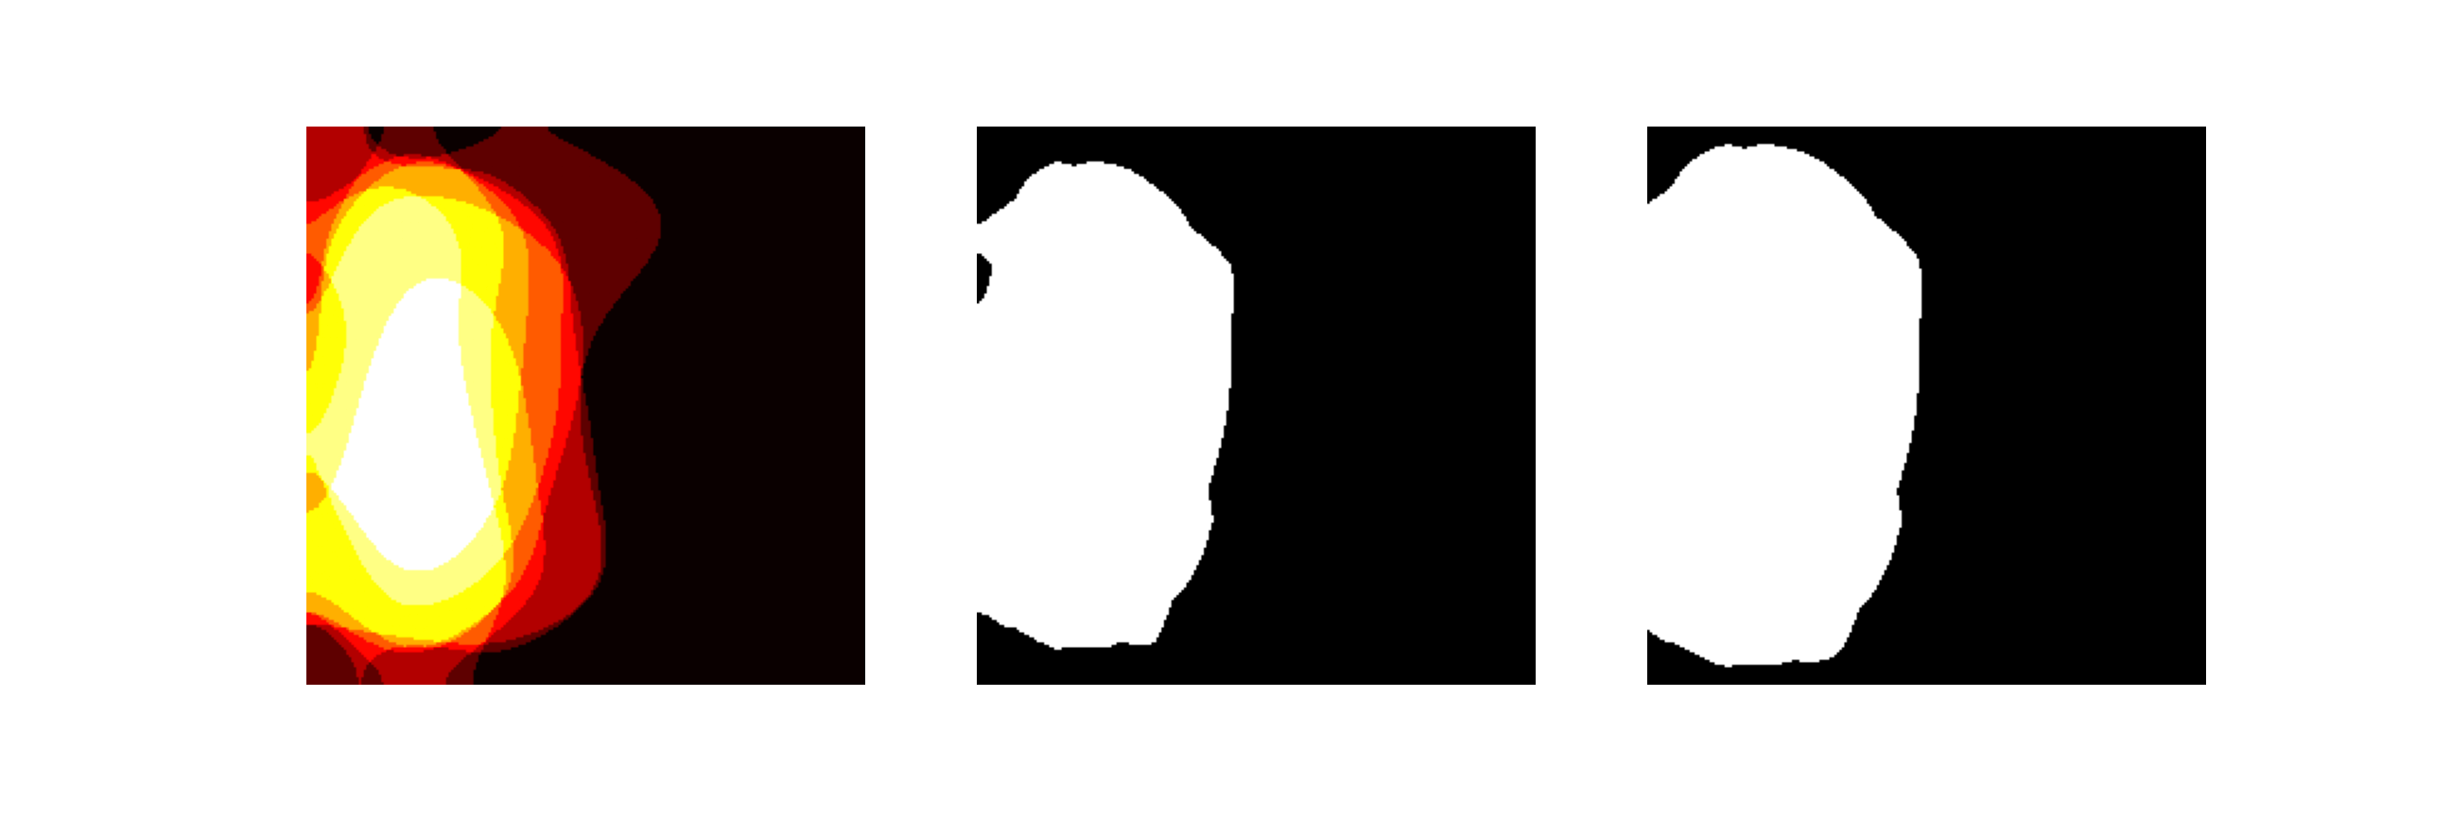

Results (4)
Visual attention mechanism
Feeding the local branch with masked images obtained from both good (top) and bad (bottom) intersections → Accuracy decrease
13
Notes:
We think that an explanation for this decrease in accuracy could be that we fed the local branch with masked images obtained from both good and bad intersections.

Slide 16
Concluding remarks
Artifacts management improve classification performances.
High degree of staining variation is not a limit for automated lymphoma subtypes classification.
Splitting images into patches is the winning strategy.
Decreasing model complexity leads to slightly lower but comparable classification performances.
Inclusion of visual attention mechanism in the processing pipeline worsen classification performances.
Explainable deep learning could be the meeting point between machine learning and physicians.
Limitations of the study
Based on a limited dataset including only 3 lymphoma subtypes and histological data (e.g., no molecular data).
No clinical confirmation of the areas of interest indicated by the heatmaps.
Further step: Ask human hematopathologist to annotate regions of interest in images.
14
Notes:
To conclude, we demonstrated that
Artifacts management improve classification performances
High degree of staining variation is not a limit for automated lymphoma subtypes classification
Splitting images into patches is the winning strategy (maybe because not all the parts of the images represent diseased tissue)
Decreasing model complexity leads to slightly lower but comparable classification performances
Inclusion of visual attention mechanism in the processing pipeline worsen classification performances
We believe that explainable deep learning could be the meeting point between machine learning and physicians, who often refuse to use artificial intelligence techniques to treat their patients because of a lack of transparency in the process. For this reason, reassuring doctors about how machines come to a decision may be the only way to show impact of deep learning models in medical domain.
This project has some limitations. First, it is based on a dataset including only three lymphoma subtypes and use a dataset including more could be suitable. In addition, this dataset does not include for example molecular data, which has been demonstrated to be relevant to identify lymphoma subtypes. Second, there is no clinical confirmation about the reliability of the areas of interest indicated by the heatmaps. Further development of this work could be asking human hematomathologist to annotate regions of interest in images.

Slide 17
Thanks for your attention!
Notes:
FINE CHIARA

